Slide 1
Decision Tree

Slide 2
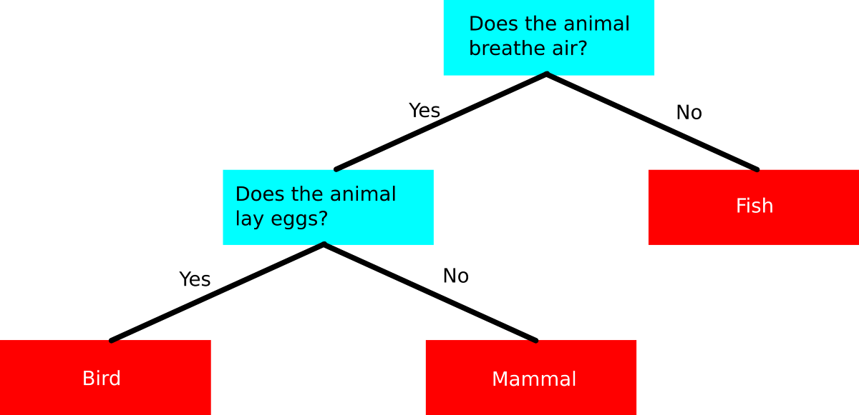
Decision Tree
A decision tree is a graphical representation of all the possible solutions to a decision based on certain conditions.
Decision tree is a type of supervised learning algorithm (having a pre-defined target variable) that is mostly used in classification problems.
The decision tree analyses a data set in order to construct a set of rules, or questions, which are used to predict a class.
These involve stratifying or segmenting the predictor space into a number of simple regions.
Example:
Let us consider a dataset consisting lots of different animals and some of their characteristics.
With the help of these characteristics, can predict their class.
The tree can be explained by two entities, namely decision nodes and leaves. The leaves are the decisions or the final outcomes. And the decision nodes are where the data is split

Slide 3
Types of Decision Tree
Types of decision tree is based on the type of target variable we have. It can be of two types:
Categorical Variable Decision Tree: Decision Tree which has categorical target variable. Also we can define it as classification problem.
Example: based on medical history weather a patient detect with cancer or not.
Continuous Variable Decision Tree: Decision Tree has continuous target variable or a regression problem.
Example: to predict the house price based on certain variables.

Slide 4
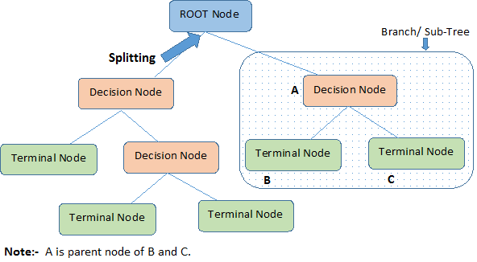
Terminology used in Decision Tree
Root Node: It represents entire population or sample and this further gets divided into two or more homogeneous sets.
Splitting: It is a process of dividing a node into two or more sub-nodes.
Decision Node: When a sub-node splits into further sub-nodes, then it is called decision node.
Leaf/ Terminal Node: Nodes do not split is called Leaf or Terminal node.
Pruning: It reduces the size of decision trees by removing parts of the tree that do not provide power to classify instances.
Branch / Sub-Tree: A sub section of entire tree is called branch or sub-tree.
Parent and Child Node: A node, which is divided into sub-nodes is called parent node of sub-nodes where as sub-nodes are the child of parent node.

Slide 5
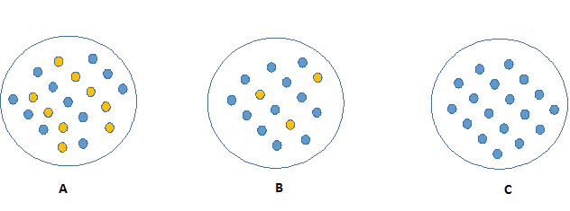
Split of Tree
In this procedure all the features are considered and different split points are tried and tested using a cost function. The split with the best cost (or lowest cost) is selected.
The decision of making strategic splits heavily affects a tree’s accuracy. The decision criteria is different for classification and regression trees.
we can say that purity of the node increases with respect to the target variable. Decision tree splits the nodes on all available variables and then selects the split which results in most homogeneous sub-nodes.

Slide 6
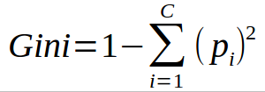
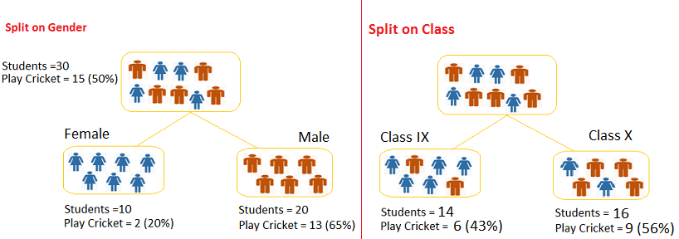
A Tree Decide Where To Split:
Gini Index
The impurity (or purity) measure used in building decision tree in classification is Gini Index.
It performs only Binary splits
Higher the value of Gini higher the homogeneity.
Example:
There are 30 students, out of which 15 plays cricket. Identify which split is producing more homogeneous sub-nodes with the help of Gini index.

Slide 7
A Tree Decide Where To Split:
Split on Gender:
Calculate, Gini for sub-node Female = (0.2)*(0.2)+(0.8)*(0.8)=0.68
Gini for sub-node Male = (0.65)*(0.65)+(0.35)*(0.35)=0.55
Calculate weighted Gini for Split Gender = (10/30)*0.68+(20/30)*0.55 = 0.59
Similar for Split on Class:
Gini for sub-node Class IX = (0.43)*(0.43)+(0.57)*(0.57)=0.51
Gini for sub-node Class X = (0.56)*(0.56)+(0.44)*(0.44)=0.51
Calculate weighted Gini for Split Class = (14/30)*0.51+(16/30)*0.51 = 0.51
Above, Gini score for Split on Gender is higher than Split on Class, hence, the node split will take place on Gender.

Slide 8
Information Gain:
The attribute with highest information gain is considered the best.
Less impure node requires less information to describe it.
And, more impure node requires more information.
Information theory is measure to define this degree of disorganization in a system known as Entropy.
If the sample is completely homogenous, then the entropy is zero and if the sample is an equally divided (50% - 50%), it has entropy of one.

Slide 9
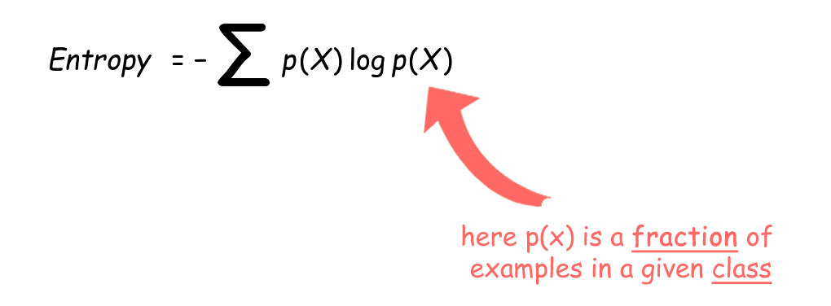
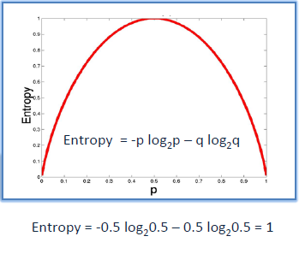
Entropy
Entropy is measure of impurity, disorder or uncertainty.
It is measure of randomness, how random the data is.

Slide 10


Let’s consider an example
Here in the table, Grade and Speed limit are the features and Speed is label
In the Grade column there are four values and correspond that values there are four labels.
Lets consider all the labels as a parent node.
SSFF => parent node
So, what is the entropy of this parent node ?
p(slow) = no. of slow examples in parent node / total number of examples
Similarly, for p(fast)
Grade | Speed limit | Speed
Steep | Yes | Slow
Steep | Yes | Slow
flat | no | fast
steep | no | fast

Slide 11
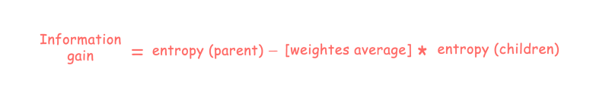
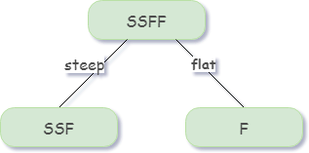
So, the entropy of parent node:
Entropy(parent) = - {0.5 log2(0.5) + 0.5 log2(0.5)}
= - {-0.5 + (-0.5)}
= 1
So the entropy of parent node is 1.
We can derive information gain from entropy as
Algorithm construct a Decision Tree based on Information gain
First lets check whether the parent node split by Grade or not.
To find out Information gain of Grade feature, we need to
virtually split the parent node by Grade feature.
Entropy of right child node (F) is 0, because this node belongs
to the same class.

Slide 12

Lets find out Entropy of the left side node SSF:
In this node SSF there are two type of examples present, so we need to find out the fraction of slow and fast example separately for this node.
  P(slow) = 2/3 = 0.667
  P(fast) = 1/3 = 0.334
Entropy(SSF) = - {0.667 log2(0.667) + 0.334 log2(0.334)}
= - {-0.38 + (-0.52)}
= 0.9
Now, we need to find out Entropy(children)with weighted average.
Total number of examples in parent node: 4
# left child node: 3
# right child node: 1
Entropy(children) with weighted avg. is = 0.675
  So,
Information gain(Grade) = 1 - 0.675 = 0.325
Information gain from Grade feature is 0.325 .

Slide 13
Chi-Square
It is an algorithm to find out the statistical significance between the differences between sub-nodes and parent node. We measure it by sum of squares of standardized differences between observed and expected frequencies of target variable.
It works with categorical target variable “Success” or “Failure”.
It can perform two or more splits.
Higher the value of Chi-Square, higher the statistical significance of differences between sub-node and Parent node.
Chi-Square of each node is calculated using formula,
Chi-square = ((Actual – Expected)^2 / Expected)^1/2
It generates tree called CHAID (Chi-square Automatic Interaction Detector)

Slide 14
Split on Gender:
First we are populating for node Female, Populate the actual value for “Play Cricket” and “Not Play Cricket”, here these are 2 and 8 respectively.
Calculate expected value for “Play Cricket” and “Not Play Cricket”, here it would be 5 for both because parent node has probability of 50% and we have applied same probability on Female count(10).
Calculate deviations by using formula, Actual — Expected. It is for “Play Cricket” (2–5 = -3) and for “Not play cricket” ( 8–5 = 3).
Calculate Chi-square of node for “Play Cricket” and “Not Play Cricket” using formula.
Follow similar steps for calculating Chi-square value for Male node.
Now add all Chi-square values to calculate Chi-square for split Gender.

Slide 15
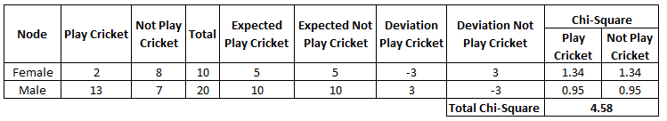
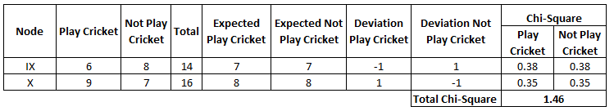
Split on Class:
Perform similar steps of calculation for split on Class and you will come up with below table.

Slide 16
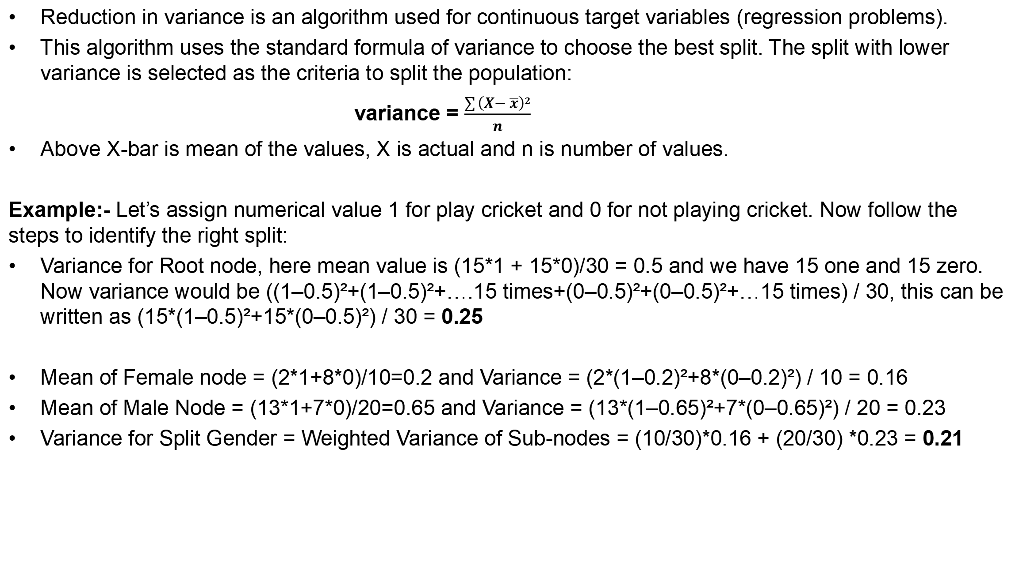
Reduction in Variance
Reduction in variance is an algorithm used for continuous target variables (regression problems).
This algorithm uses the standard formula of variance to choose the best split. The split with lower variance is selected as the criteria to split the population:
variance = $\frac{\sum{\left(X−\overline{x}\right)2}}{n}$
Above X-bar is mean of the values, X is actual and n is number of values.
Example:- Let’s assign numerical value 1 for play cricket and 0 for not playing cricket. Now follow the steps to identify the right split:
Variance for Root node, here mean value is (15*1 + 15*0)/30 = 0.5 and we have 15 one and 15 zero. Now variance would be ((1–0.5)²+(1–0.5)²+….15 times+(0–0.5)²+(0–0.5)²+…15 times) / 30, this can be written as (15*(1–0.5)²+15*(0–0.5)²) / 30 = 0.25
Mean of Female node = (2*1+8*0)/10=0.2 and Variance = (2*(1–0.2)²+8*(0–0.2)²) / 10 = 0.16
Mean of Male Node = (13*1+7*0)/20=0.65 and Variance = (13*(1–0.65)²+7*(0–0.65)²) / 20 = 0.23
Variance for Split Gender = Weighted Variance of Sub-nodes = (10/30)*0.16 + (20/30) *0.23 = 0.21

Slide 17
Reduction in Variance
Mean of Class IX node = (6*1+8*0)/14=0.43 and Variance = (6*(1–0.43)²+8*(0–0.43)²) / 14= 0.24
Mean of Class X node = (9*1+7*0)/16=0.56 and Variance = (9*(1–0.56)²+7*(0–0.56)²) / 16 = 0.25
Variance for Split Gender = (14/30)*0.24 + (16/30) *0.25 = 0.25
Above, you can see that Gender split has lower variance compare to parent node, so the split would take place on Gender variable.

Slide 18
Pruning
One of the questions that arises in a decision tree algorithm is the optimal size of the final tree.
A tree that is too large risks overfitting the training data and poorly generalizing to new samples.
A small tree might not capture important structural information about the sample space
A common strategy is to grow the tree until each node contains a small number of instances then use pruning to remove nodes that do not provide additional information.
We start at the bottom and start removing leaves which are giving us negative returns when compared from the top.

Slide 19
THANK YOU FOR YOUR
ATTENTATION

